Slide 1
C++ Presentation
欧锋/Ophone/New comer
Feng.Ou@tieto.com

Slide 2
Agenda
Function & Operator Overloading
C++ class/struct
Design a singleton
Inheritation-Derive Class
Virtual function

Slide 3

Function & Operator Overloading
When two or more different declarations are specified for a single name in the same scope, that name is said to be overloaded.(ISO14882, chs 13)

Slide 4
Function & Operator Overloading
C++ allows overloading of all function names and nearly all operators that handle user-defined types.
You may not overload:
the scope resolution operator ::
the member selection (dot) operator .

Slide 5
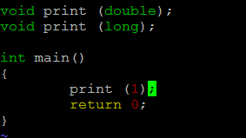
Question#1 for overloading
https://github.com/Morpheusou/TCPL/blob/master/chapter12/12.3.1_1.cpp

Slide 6
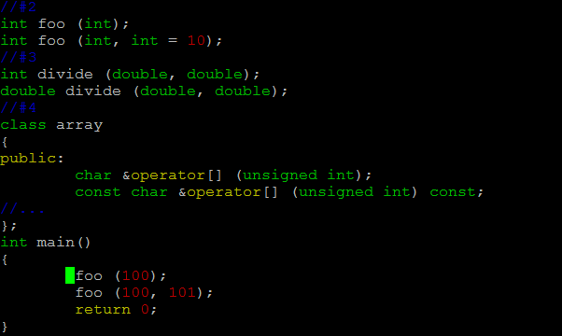
Question#2 for overloading
https://github.com/Morpheusou/TCPL/blob/master/chapter12/ambiguous.cpp

Slide 7
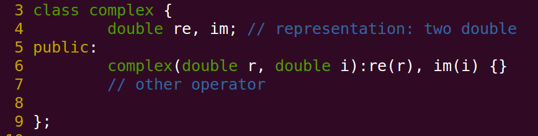
C++ class/struct-definition
[BS] A class is a user-defined type provided to represent a concept in the code of program.
https://github.com/Morpheusou/TCPL/blob/master/demo/class.cpp
Notes:
BS=Bjarne Stroustrup

Slide 8

Puzzle#1 class/struct
https://github.com/Morpheusou/TCPL/blob/master/demo/class.cpp

Slide 9
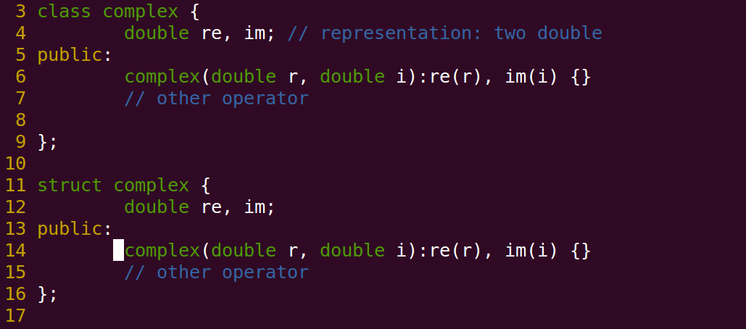
Question#3 class/struct
https://github.com/Morpheusou/TCPL/blob/master/demo/class.cpp

Slide 10
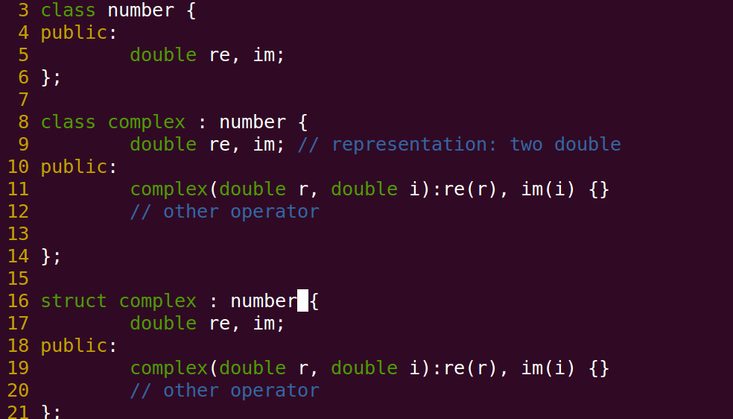
Question#4 class/struct
https://github.com/Morpheusou/TCPL/blob/master/demo/class.cpp

Slide 11
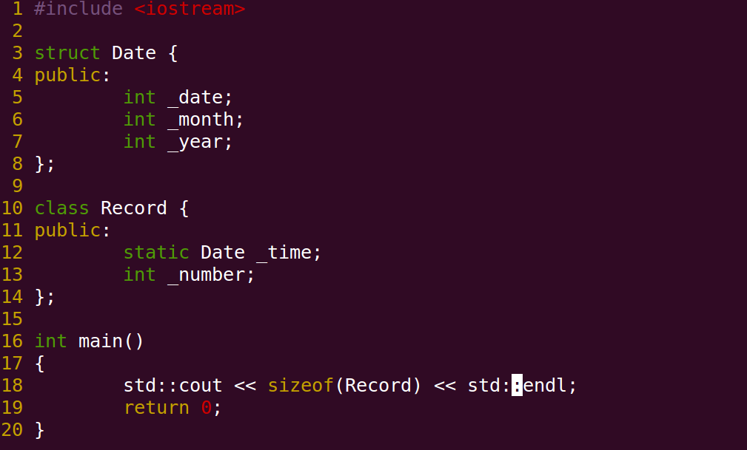
Question#5 static member
https://github.com/Morpheusou/TCPL/blob/master/demo/static.cpp

Slide 12
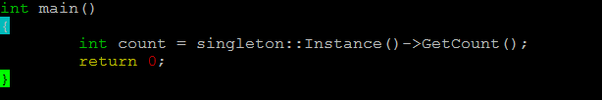
Singleton
Ensure a class only has one instance
static global variable
Provide a global point of access to it
File variable – extern vs static
extern function
https://github.com/Morpheusou/TCPL/blob/master/demo/singleton.cpp

Slide 13
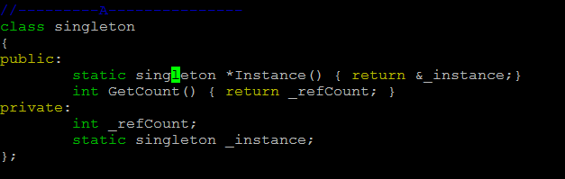
Singleton implementation #A
https://github.com/Morpheusou/TCPL/blob/master/demo/singleton.cpp

Slide 14
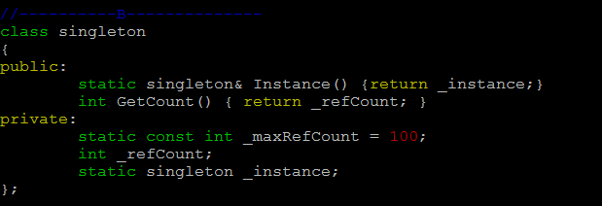
Singleton implementation #B
https://github.com/Morpheusou/TCPL/blob/master/demo/singleton.cpp

Slide 15
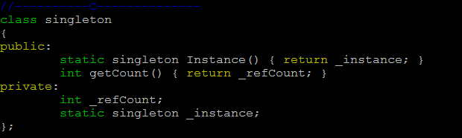
Singleton implementation #C
https://github.com/Morpheusou/TCPL/blob/master/demo/singleton.cpp

Slide 16
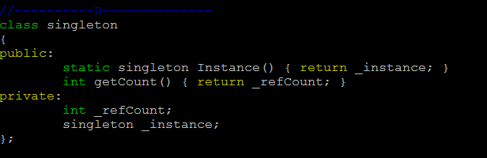
Singleton implementation #D
https://github.com/Morpheusou/TCPL/blob/master/demo/singleton.cpp

Slide 17
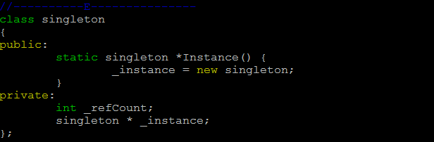
Singleton implementation #E
https://github.com/Morpheusou/TCPL/blob/master/demo/singleton.cpp

Slide 18
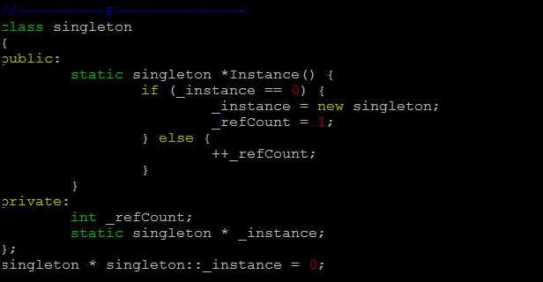
Singleton implementation #F
https://github.com/Morpheusou/TCPL/blob/master/demo/singleton.cpp
Notes:
Inline function within class definition.

